Slide 1

Machine Learning & The Masters
Jake Clauson, Monica Puffer,
Krissy Santucci, Cody Sellers

Slide 2

Goal
Create an optimized machine learning model that can predict a Golfer’s score and/or probability of placing in the top 10 at a future PGA Masters Tournament.

Slide 3
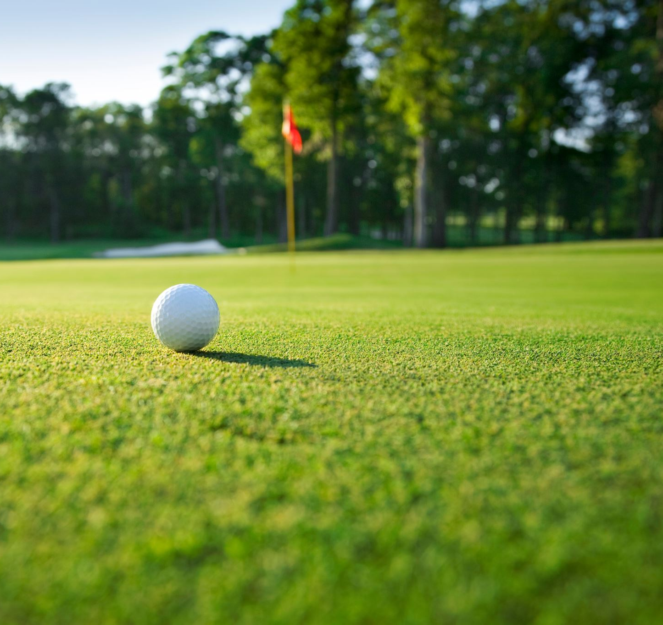
Data
Source: Kaggle (PGATour.com web scrape)
Statistics of all players on the PGA Tour from 2010 to 2018 seasons – summarized by year.
Statistics can be divided into the following categories:
Off The Tee
Approach The Green
Around The Green
Putting

Slide 4

How is Golf Played?
Goal: get your ball from the tee (the starting point of any hole) to the green and ultimately into the hole in as few shots as possible.
The total number of shots a player takes to get the ball into each hole is added together.
Events are held over four days and the winner is the player who completes 72 holes (four rounds of 18, almost always on the same course) in the fewest number of shots (also called strokes).

Slide 5
Dependent Variable – Strokes Gained
Compares a player's performance to the rest of the field and isolates individual aspects of the game: Off-the-Tee, Approach-the-Green, Around-the-Green, Putting.
Example:
TPC Sawgrass' 18th hole is a 446-yard, par-4. The PGA TOUR's scoring average, or baseline, on a par-4 of that length is 4.100. Fowler hit his tee shot on No. 18 in the fairway, 116 yards from the hole. The TOUR scoring average from the fairway, 116 yards from the hole, is 2.825. He gained 0.275 strokes on his tee shot. Here's how:
Baseline for tee - Baseline for second shot - 1 = strokes gained: off-the-tee 4.100 - 2.825 = 1.275 - 1 = +0.275
A positive “Stroke Gained” statistic is good!

Slide 6
Strokes Gained - Analysis
Is there an area of the game (off-the-tee, putting, etc.) that winners tend to excel at over non-winners?
Are there variables within those key areas of the game that correlate to strokes gained that we can use to build a predictive model?

Slide 7

Process
Label Top 10 golfers from each years Masters tournament.
Create k-means clusters for all players based off strokes gained in four key categories:
Off-the-Tee
Approach-the-Green
Around-the-Green
Putting
Observe what group our “Masters top 10” were in and noted what key categories they excelled in vs. non-winners.
Test sub-variables within key categories for correlation to strokes gained.
Future – build a model of 15-20 features to predict a player’s total score/Top 10 probability in a future Masters Tournament.

Slide 8
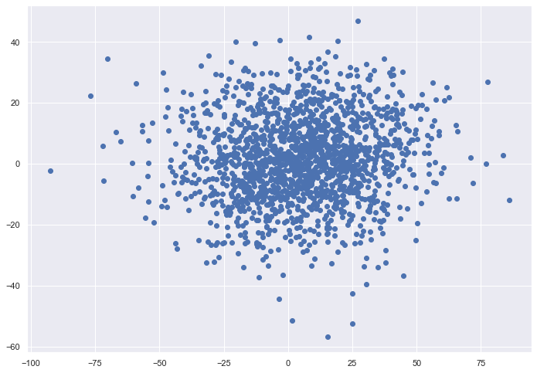
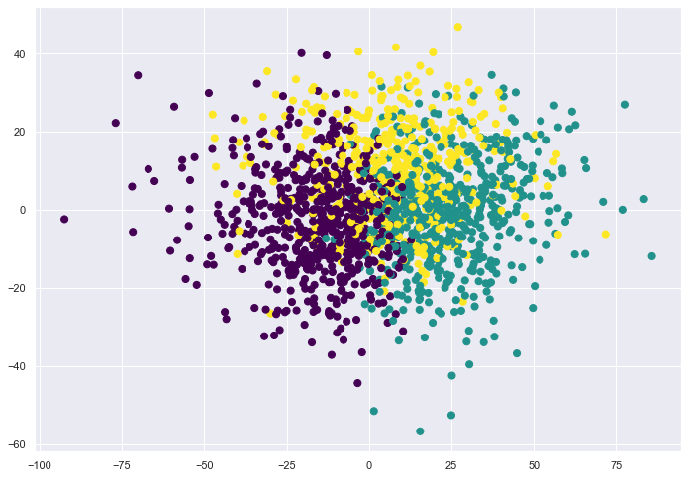
K-Means Cluster

Slide 9

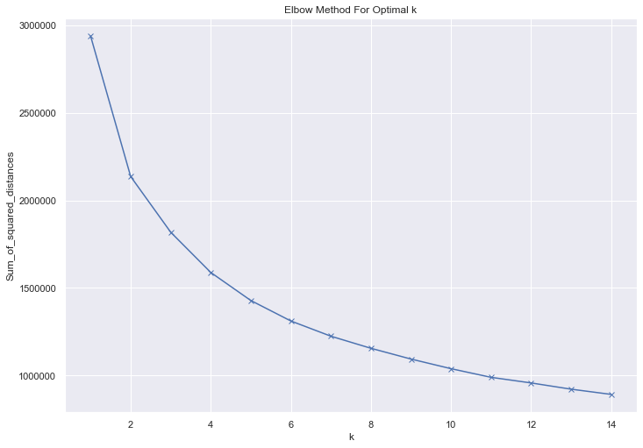
K-Means – Centers and Optimal K

Slide 10

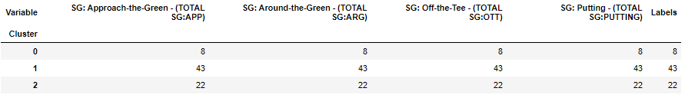

Masters Top Performers Analysis

Slide 11

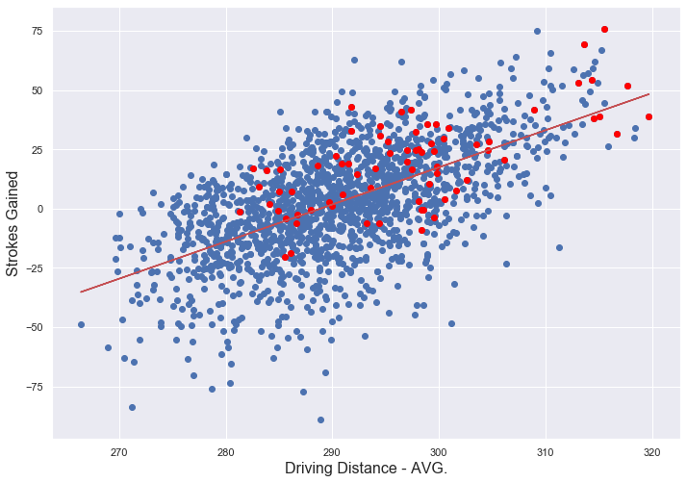
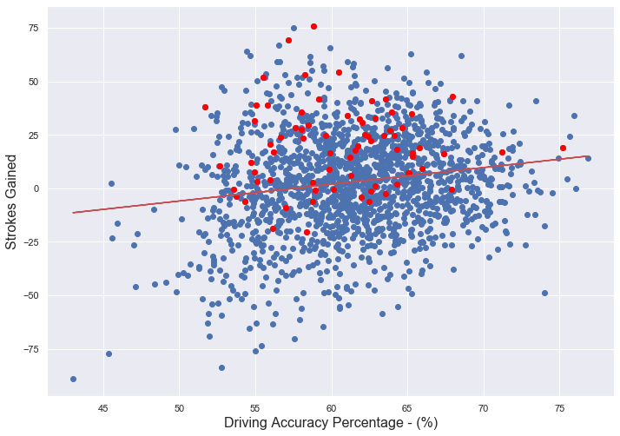
Off-the-Tee: Distance or Accuracy?
The r-squared is: 0.5997471787162839
The r-squared is: 0.16971707078940673
*Driving Distance – AVG: The average number of yards per measured drive. These drives are measured on two holes per round. Care is taken to select two holes which face in opposite directions to counteract the effect of wind. Drives are measured to the point at which they come to rest regardless of whether they are in the fairway or not.
*Driving Accuracy %: The percentage of time a tee shot comes to rest in the fairway (regardless of club)

Slide 12
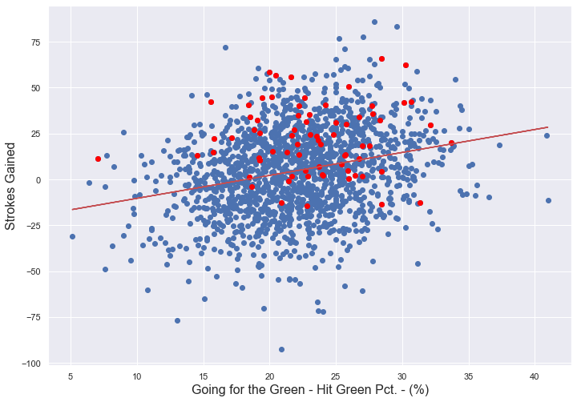
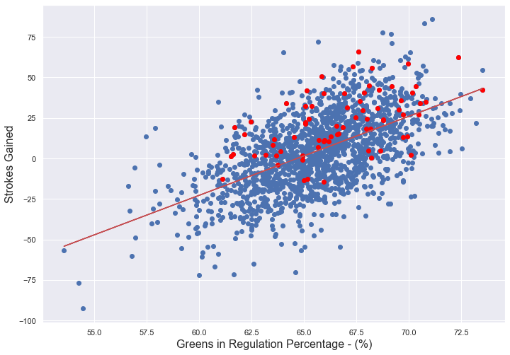
Approach-the-Green: Go for it or lay up?
The r-squared is: 0.26177352254680647
The r-squared is: 0.5711537401014711
*Going for the Green – Hit Green % : The percent of time a player attempting to go for the green is successful. A player is assumed to be going for the green if the first shot on a par 4 or second shot on a par 5 lands on or around the green (30 yards to pin).
*Greens in Regulation % : The percent of time a player was able to hit the green in regulation (greens hit in regulation/holes played). Note: A green is considered hit in regulation if any portion of the ball is touching the putting surface after the GIR stroke has been taken. (The GIR stroke is determined by subtracting 2 from par (1st stroke on a par 3, 2nd on a par 4, 3rd on a par 5))

Slide 13
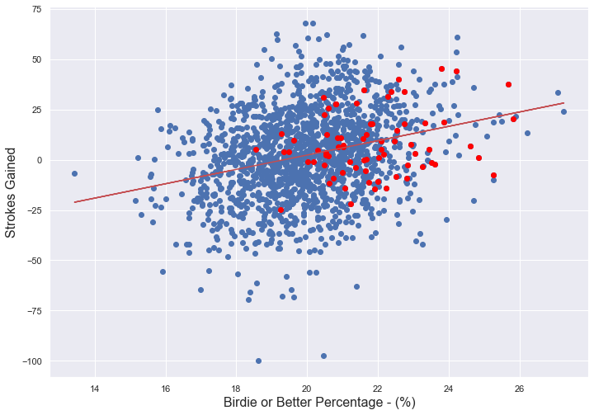
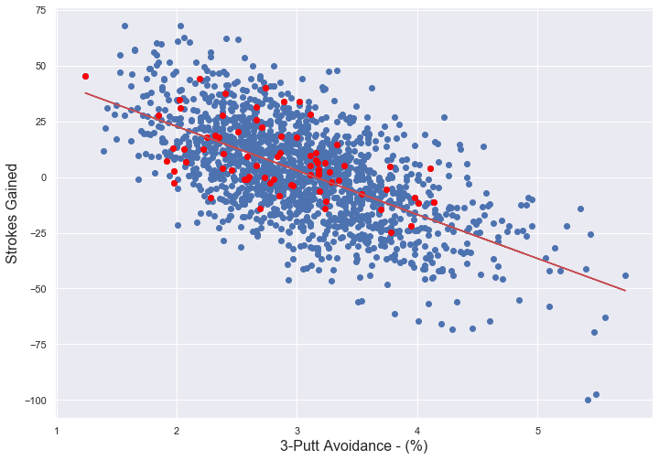
Putting: Aggressive vs. Risk Averse
The r-squared is: 0.27903353827410027
The r-squared is: -0.620857044847256
*Birdie or Better %: The percent of time a player makes birdie or better after hitting the green in regulation.
*3-Putt Avoidance %: The percent of time 3 or more putts were taken for a hole (total 3-putts, 4-putts, etc./ total holes played).

